Slide 1
Computer Vision Fundamentals
Lecture 3 - Part 2
Image Display

Slide 2
Contents
imshow( ) function
Binary images
Bit planes
Spatial Resolution

Slide 3
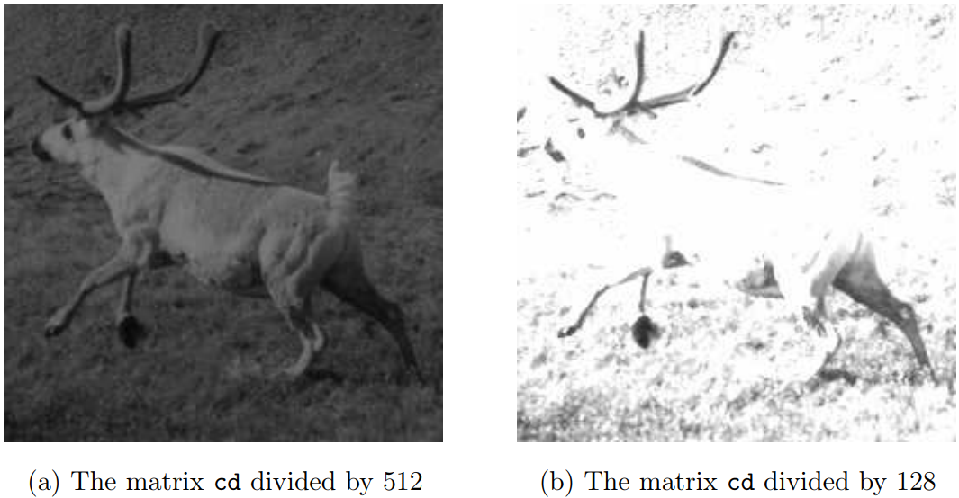
imshow( ) Function
We could display this image directly, without saving its grey values to a matrix, with the command
>> imshow(cd/512)
>> imshow(cd/128)

Slide 4
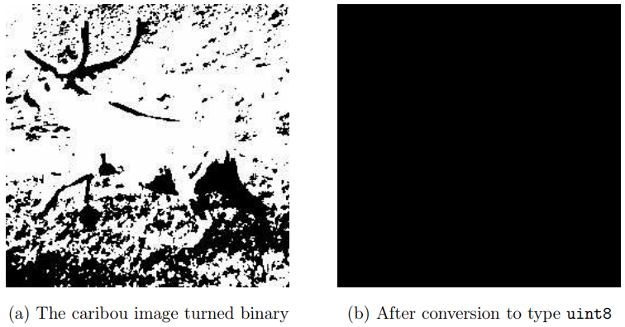
Binary Images
We could display this image directly, without saving its grey values to a matrix, with the command
>> cl=c>120;
This means that the command below will display the matrix as a binary image
>> imshow(cl);

Slide 5
Bit planes
Greyscale images can be transformed into a sequence of binary images by breaking them up into their bit-planes.
>> c0=mod(cd,2); >> c1=mod(floor(cd/2),2); >> c2=mod(floor(cd/4),2); >> c3=mod(floor(cd/8),2); >> c4=mod(floor(cd/16),2); >> c5=mod(floor(cd/32),2); >> c6=mod(floor(cd/64),2); >> c7=mod(floor(cd/128),2);
Note that the least significant bit plane, c0, is to all intents and purposes a random array, and that we see more of the image appearing. The most significant bit plane, c7, is actually a threshold of the image at level 127:

Slide 6
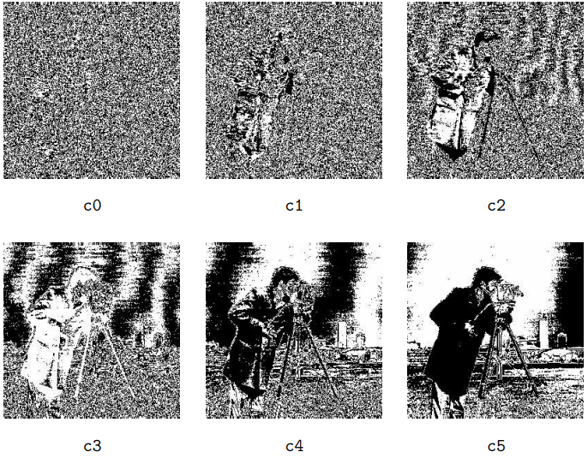
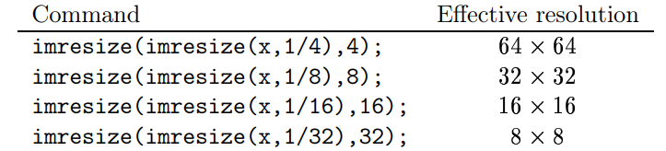
Spatial Resolution
Spatial resolution is the density of pixels over the image: the greater the spatial resolution, the more pixels are used to display the image
>> imresize(x,1/2);

Slide 7
Thankyou

